Slide 1
FONDATIONS FOR STONE ARCH BRIDGES
Dr John K. Makunza
University of Dar es Salaam
© 2013

Slide 2
1.0 INTRODUCTION
Stone masonry is the art of building structures in stones. Stones may be used for the construction of foundations, columns, walls, beams, lintels, arches, etc, of buildings. Dams, retaining walls, and other structures can also be built from stones. Stones are available in nature, and after working/cutting to the required shapes, they provide strong, durable and economical material for construction. The availability of stones limit their use as they are not available every where. Structurally, stones provide higher strength, are more durable and weather resistant than bricks/blocks.

Slide 3
Quality of stones required for masonry work
Stones for masonry work have to be strong in the same manner as those used for producing coarse aggregates. For building purposes, stones from sedimentary rocks are the best because they have a better regular shape.
The size of the stones shall be in such away that the length dimension does not exceed 5 times the thickness dimension.
The worked/dressed stones should be laid in position such that the whole stone is surrounded by cement mortar so as to provide a strong bond and ensure even distribution of the loads.

Slide 4
The Romans were the first nation who took masonry arch construction into action and developed it in their Empire; Mediterranean and Europe. They built roads and bridges from masonry construction for they knew that their success depended on efficient permanent communication.

Slide 5
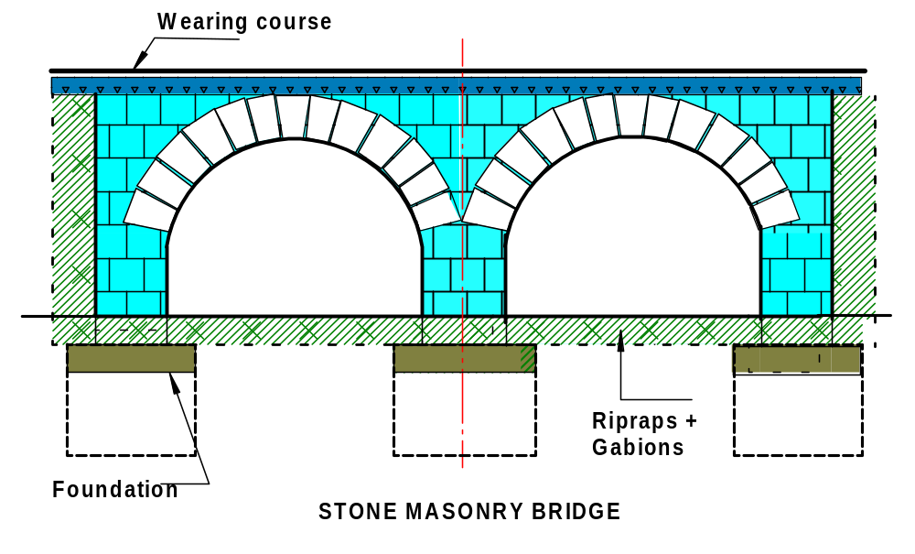
STONE ARCH BRIDGE
Figure 1: Stone arch bridge

Slide 6
2.0 FOUNDATIONS
A foundation is required to transmit and distribute the loads from the whole structure to the subsoil in the ground. This transmission of loads must be accomplished without exceeding the bearing capacity of the soil in order to avoid failure or excessive settlement of the structure.
A certain type of foundation is chosen depending on:
- the depth to a suitable stratum
- the magnitude of the applied loads
- bearing capacity of the stratum
- the proximity of other structures and foundations
- access to equipment and machines

Slide 7
Functions of Foundations
The foundation system for a structure is the critical link in the transmission of loads down to the ground. Bearing directly on the soil, the foundation system must;
Distribute the loads so that the settlement of a structure is either negligible or uniform under all parts of the structure.
Anchor the superstructure to prevent uplifting due to wind and earthquake forces.

Slide 8
Aspects to be considered during foundation design
The task is to be able to select and provide the right type of foundation which involves a choice from different types of foundations. It is therefore imperative to know the behavior of foundations, construction of foundations and cost of foundations. It is also important to have a correct choice of the analysis method. The right choice results into considerable financial saving and of course a safe design. The majority of bridges on a highway are small and medium sizes.

Slide 9
Easy, simple and quick to construct types of bridge designs should be favoured to avoid a need for specialists. Normally speed results in saving and this can be achieved by use of:-
Repetitive and simple procedures
Readily available construction materials
Simple foundation shapes
A level bottom foundation
Simple details which can be adjusted on site
Horizontal and vertical surfaces for foundations as much
as possible
Formwork which could be reused several times and
expensive false work should be avoided
medium sized bars as very large bars are difficult to bend

Slide 10
The construction sequence has to be considered along with the maintenance aspects such as de-silting.
The possibility of floods and flood debris during construction should be looked at because they are a problem at that stage. Apart from that scour is a major cause of bridge failures during its service time. Hence foundations have to be below the lowest scour level or bed protection works ( gabions, rip rap, etc) have to be used which are inexpensive. The bed protection works slow the flow and silting occurs filling the voids in the process stopping the scouring action of water Moreover, streamlined edges on pier above the foundation also reduce scour.

Slide 11
Construction Procedure
It is cheaper to divert the river and construct in the dry. But when the condition doesn’t allow then foundations are constructed in cofferdams.
The sheet pilling used for cofferdams can be left for scour protection. Also, subsidence of a foundation is avoided by grouting the weak soil areas (voids) or by bridging the voids. In addition, spread foundation is better in resisting differential settlement. Soil description should be in accordance to standards which are locally used. Soil data should be obtained for depth of up to the loading depth (pressure bulbs). The actual soil conditions should be compared to the laboratory results. Sometimes pile tests are done on the site to get a realistic data for design. On locations requiring piles, plate bearing tests may be done to see the possibility of eliminating use of piles.

Slide 12
It is always advisable that the designer should be involved in the site investigations whereby the designer gets the feedback, proposes locations for investigations and supervises the investigation.
Ground water may present a problem as it leads to:
- Reduced bearing capacity of substrata
- Increased lateral pressure
- Reduces stability of slopes and banks
Therefore ground water level should be known. But most ground water can be removed and controlled by pumps. Where it is impossible to de-water then construction is done under water by mass concrete.
The other data is obtained from the bridge deck design whereby the following is determined:-
Number of foundations
Loading on foundations
Size of foundations
Location of foundations

Slide 13
Types of Foundations
There are two basic types of foundations:
SHALLOW FOUNDATIONS; transfer the load to soil at the base of the substructure
DEEP FOUNDATIONS; transfer loads far below the substructure.
These foundations penetrate through ‘poor’ soil until a satisfactory bearing stratum is reached.

Slide 14
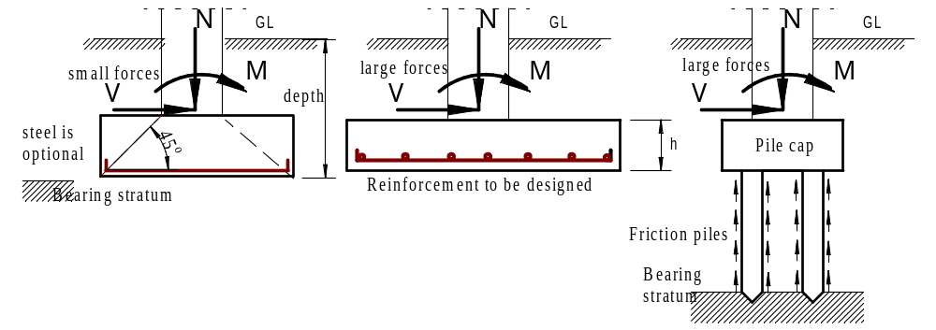
Types of Foundations

Slide 15

Shallow Foundations
For transferring building loads to underlying ground
Mostly for firm soils or light loads
firm ground
firm ground
bed rock
bed rock

Slide 16
Shallow Foundations
Characteristics of shallow foundations are; they are cheap and they require suitable soil.
There are a variety of shallow foundation types used in the construction of foundations.
For columns
Isolated pad footings
Combined or Cantilevered footing
Mat/raft footing
For walls
Strip footings
Spread Footings
Slab on grade
Mat/raft footing

Slide 17
Deep Foundations
Deep foundations transfer loads far below the substructure
mostly used in weak soils or for heavy loads
-These foundations penetrate weak soil until a satisfactory bearing stratum is reached.
-Used to reach deeper layers with greater bearing
stratum
P
I
L
E
weak soil
bed rock

Slide 18
Load Transfer Characteristics of Piles
Bearing Piles
Transfers load through unstable soils to the denser soils far below, such as bedrock
Friction Piles
- Depends on friction resistance between the soil it passes through and the surface of the pile.
- Used in clay soils
- Driven Piles & Concrete Caissons use this methods
Sheet Piles
-Designed to resist Horizontal pressures
- Used to hold back earth embankments and sides of excavation

Slide 19
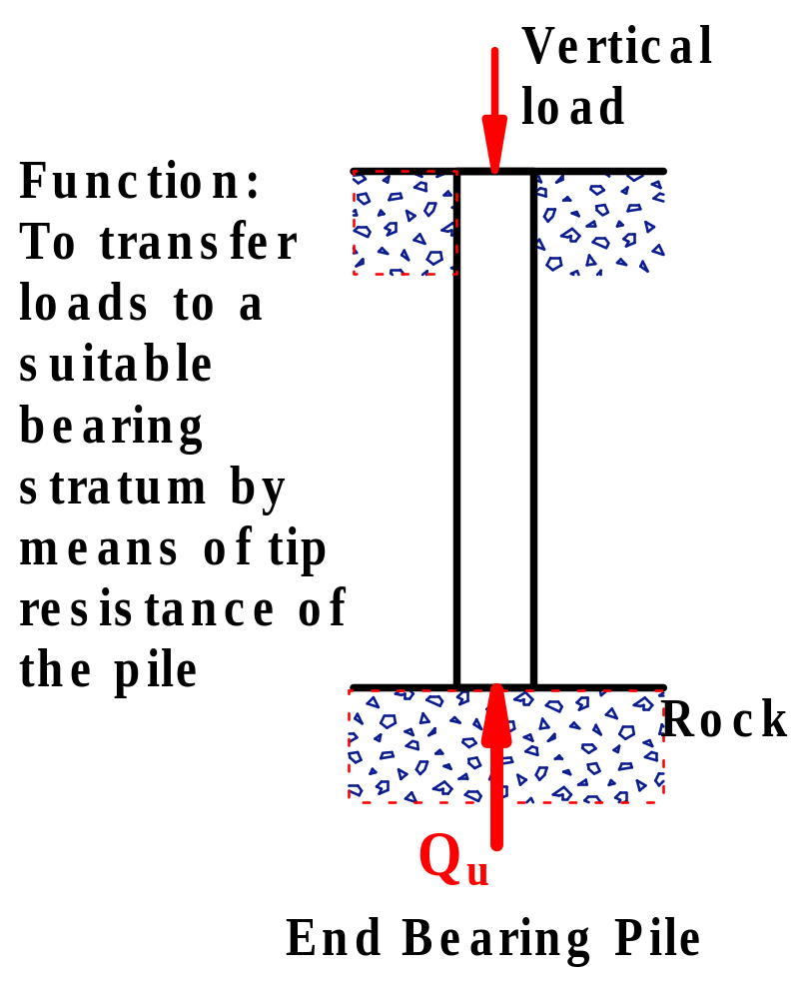
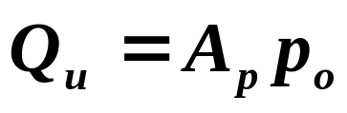
Bearing Piles
A_{p} = bearing area of the pile at tip
p_{o} = ultimate bearing capacity of the rock

Slide 20
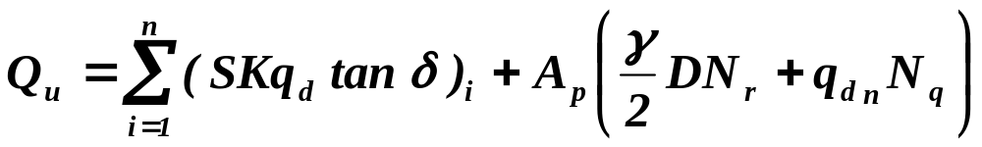
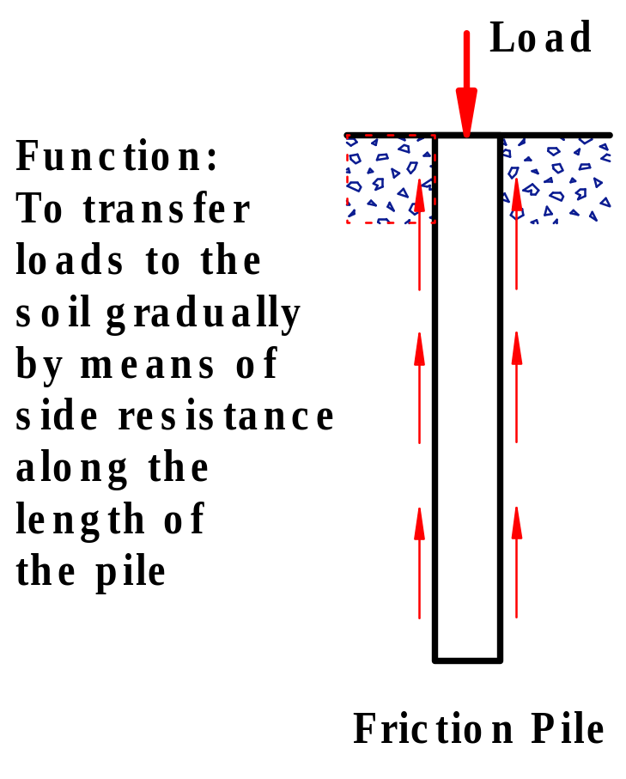
Friction Piles
Pile capacity in granular soil
where
Q_{u} = ultimate resisting capacity
A_{p} = area of cross section at tip
q_{di} = effective over burden pressure at the ith layer
D = size of the pile at tip
γ = unit weight of soil at toe
N_{r} and N_{q} = bearing capacity factors of the soil at toe
K_{i} = coefficient of lateral earth pressure at ith layer (it
varies from 1 to 3 in loose to medium sands)
S_{i} = surface area of the pile in the ith layer
δ_{i} = angle of wall friction between pile and soil in the ith
layer, it may be taken equal φ
φ = angle of internal friction of the soil
n = number of different layers through which the pile rests

Slide 21
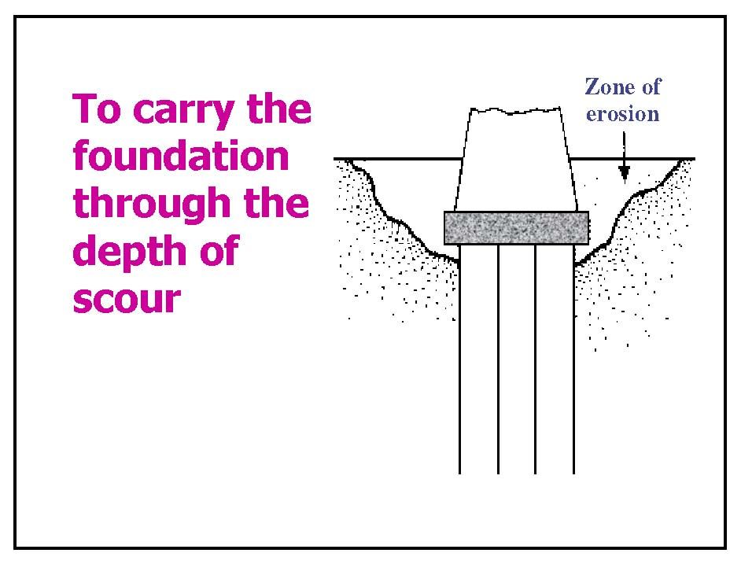

Slide 22
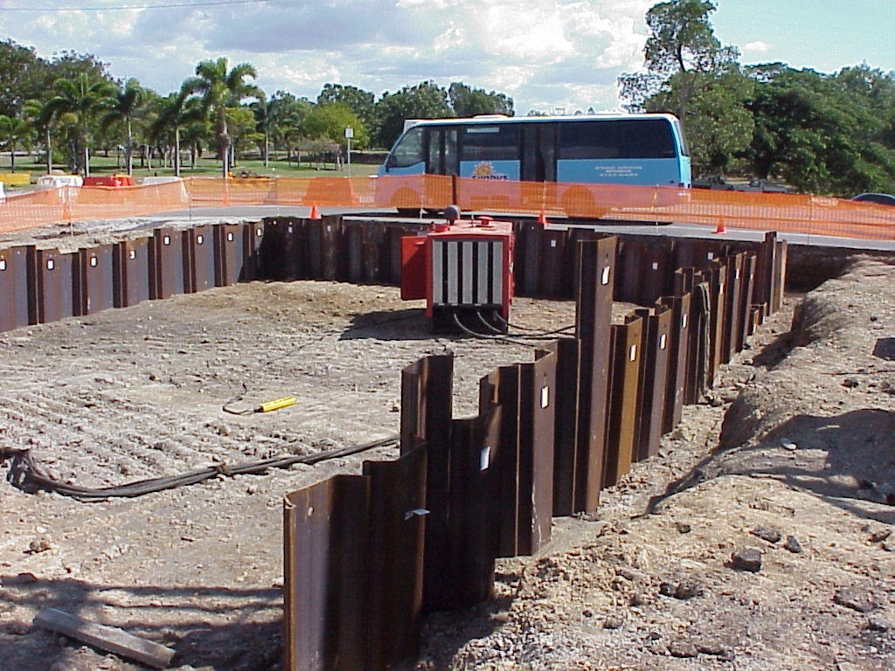
Sheet pile

Slide 23
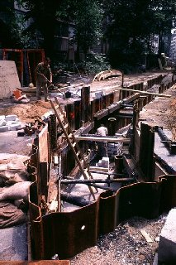
Sheet Piles
interlocking sections

Slide 24
STRUCTURAL REQUIREMENTS FOR ALL TYPES OF FOUNDATIONS
Before designing and laying foundation of any structure, site conditions, type of soils, bearing capacity of soils and loads to be transmitted through the foundation are properly assessed. Above mentioned assessments are prerequisites in order to introduce in-built protection for durability, design parameter improvement for proper layout, safety and serviceability.
1. Site Conditions
Reconnaissance of the site is done to assess topographical features*, ground conditions (natural or made-up ground, water drainage, etc.), plantation in the vicinity, neighborhood of other structures, mass movement of ground in unstable areas, etc.

Slide 25
Types of Soil
Soils supporting the foundations may be put in the following five categories from bearing capacity point of view :
Rocks
Igneous rocks and the likes without laminations are termed as hard rocks. Laminated ones such as sedimentary rocks are less strong in load bearing. Soil made of broken bed rocks, hard shells, cemented materials, etc. is another groups of rocks. The soft rocks are made of cemented materials offering high resistance to digging and excavation.
Cohesive Soils
Clays of different natural water contents are called cohesive soils. Black cotton soils, a variety of cohesive soils, form a major soil group in India, are characterized by high shrinkage and swelling properties.

Slide 26
Non-cohesive Soils
Cohesionless soils are made of gravels, sand of different sizes, silt and a combination thereof.
Peat
A ditch filled with organic matters in various stages of decomposition is known as peat.
Make-up Ground
A low water-logging or marshy land area filled with refuse, excavated soil or rock for the purpose of filling a depression or raising a site above the natural ground level is called Make-up Ground.

Slide 27
Bearing Capacity
The allowable Bearing Pressure for design shall be taken as the least of the following :
(a) The Safe Bearing Capacity on the basis of shear strength characteristics of soil, or
(b) The Bearing Pressure that soil can take without exceeding permissible settlement specified by the Code*.
Safe bearing capacity of the soil is the maximum intensity of loading that the soil will safely carry without risk of shear failure irrespective of any settlement that may occur. It is obtained by dividing the ultimate bearing capacity by a factor of safety. The ultimate bearing capacity is determined by tests for shear failure and the value of factor of safety is generally taken as 2.5. For the design of lightly loaded structures the safe bearing capacity may be obtained from Table 2.1 in the absence of the test results.

Slide 28
Table 2.1 : Safe Bearing Capacity Sl. No. | Types of Soil | Safe Bearing Capacity (kN/m²)
(1) | Rocks
(i) Hard Rocks without defect with lamination |  | 3240
(ii) Rocks with lamination |  | 1620
(iii) Residual deposits of shattered and broken bed rock, hard shell, cemented material, etc. |  | 880
(iv) Soft rock |  | 440
(2) | Non-cohesive Soils
(i) Gravel, sand and gravel, compact and offering high Resistance to penetration when excavated |  | 440
(ii) Coarse sand, compact and dry |  | 440
(iii) Medium sand, compact and dry |  | 245
(iv) Fine sand, silt (dry lump easily pulverized by fingers) |  | 150
(v) Loose gravel or sand, gravel mixture, loose coarse to medium sand, dry |  | 245
(vi) Fine sand, loose and dry |  | 100

Slide 29
Table 2.1 : Safe Bearing Capacity Sl. No. | Types of Soil | Safe Bearing Capacity (kN/m²)
(3) | Cohesive Soils
(i) Soft shale, hard or stiff clay in deep bed, dry |  | 400
(ii) Medium clay readily indented with thumb nail |  | 245
(iii) Moist clay and sand clay mixture which can be indented with strong thumb pressure |  | 150
(iv) Very soft clay indented with moderate thumb pressure |  | 100
(v) Very soft clay which can be penetrated several centimeters with thumb |  | 50

Slide 30
Typical Safety Factors
Type of Design | Safety Factor | Probability of Failure
Earthworks | 1.3-1.5 | 1/500
Retaining structures | 1.5-2.0 | 1/1500
Foundations | 2.0-3.0 | 1/5000

Slide 31
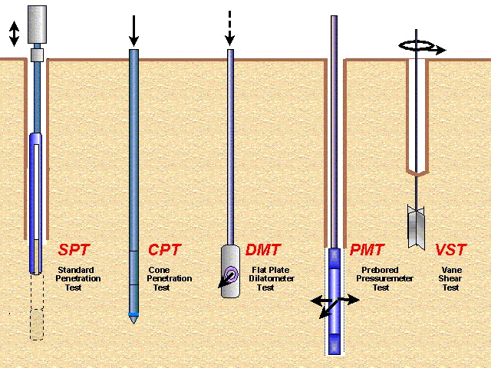
Soil Testing
Variety of Field Testing Devices

Slide 32
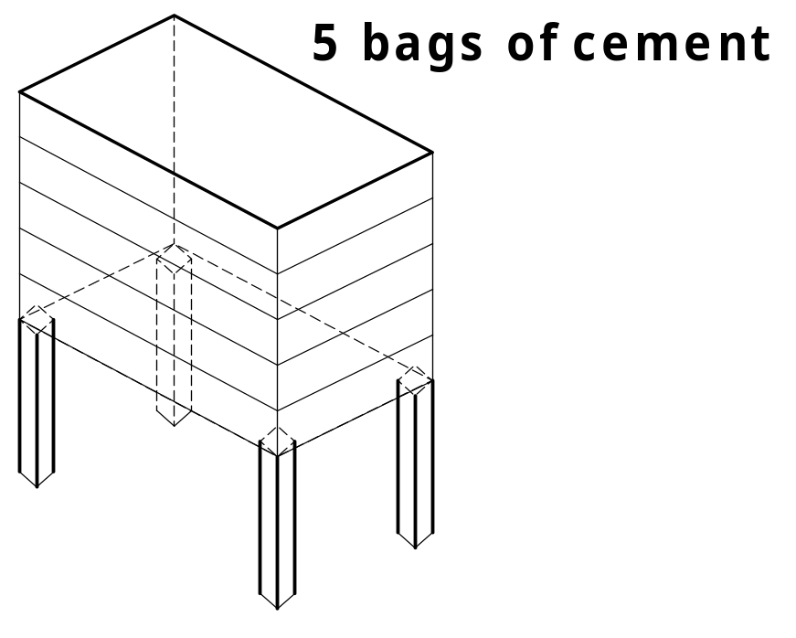
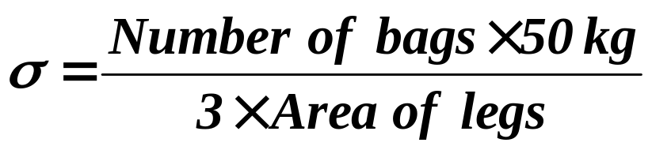
Simple Test for Soil Bearing Capacity
Where σ = soil stress
3 = Factor of safety

Slide 33
Span m | Traffic load: 40 T |  | Traffic load: 20 T
 | kN/m² | kN/cm² | kN/m² | kN/cm²
1 | 132 | 1.35 | 77 | 0.79
2 | 113 | 1.15 | 72 | 073
3 | 108 | 1.10 | 74 | 0.75
4 | 109 | 1.11 | 80 | 0.81
5 | 113 | 1.16 | 88 | 0.90
6 | 121 | 1.23 | 98 | 1.00
7 | 129 | 1.32 | 109 | 1.11
8 | 139 | 1.42 | 121 | 1.23
9 | 150 | 1.53 | 133 | 1.36
10 | 161 | 1.64 | 146 | 1.49
11 | 173 | 1.77 | 159 | 1.62
12 | 185 | 1.89 | 172 | 175
13 | 198 | 2.02 | 186 | 1.89
14 | 211 | 2.15 | 200 | 2.03
15 | 224 | 2.29 | 213 | 2.17
16 | 238 | 2.42 | 227 | 2.32
17 | 246 | 2.50 | 236 | 2.41
18 | 265 | 2.70 | 256 | 2.60
19 | 279 | 2.85 | 270 | 2.75
20 | 293 | 2.99 | 284 | 2.90
Table 2.2: Minimum Strength that can bear the weight of sand

Slide 34
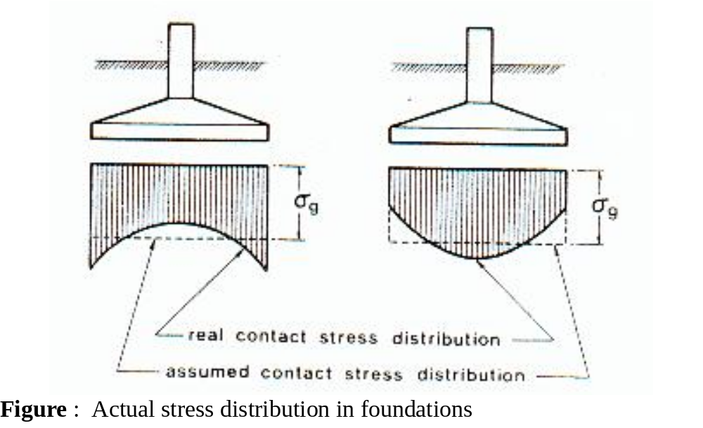
Stress Distribution

Slide 35
Rules for a simple strip foundation design
P
t
For example:
Width of foundation strip 600 mm
Width of wall
− 257 mm
2 x projection (P)
343 mm
... P =
343
2
P = 172 mm

Slide 36
DESIGN OF FOUNDATION
Depth of Foundation
While deciding depth of foundation below finished ground level, the following main considerations may be kept in view :
(a) In normal conditions, the depth of foundation shall not be less than 0.5 m. This condition, however, does not apply to foundation on rocks.
(b) In sandy or silty soils, the depth of foundation shall be enough so that the foundation remains unaffected by scour in the rainy season as well as by frost in the winter.
(c) In case of black cotton soils, the depth of foundation shall be such that mass movement of soils due to drying and shrinkage have no effect on the foundations.

Slide 37
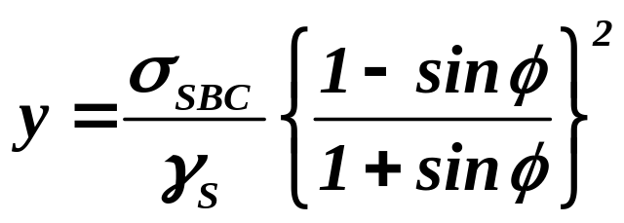
(d) Desired allowable bearing capacity must be ensured at the design depth of foundation.
(e) Rankine formula, i.e.
may be used for cohesionless soils for obtaining depth of foundation of light structures.
The applied load through walls are spread by gradually increasing in steps the area of the footings, to such an intensity of load that the bearing capacity of the soil is not exceeded.
The angle of spread from the base of the wall to the outer edges of the footing in contact with the soil shall not exceed For brick or stone masonry; ½ horizontal to 1 vertical. The minimum thickness of footing of different materials may be not less than
Wall thickness (or 150 mm).

Slide 38
EXAMPLE
Example 1:
Design the masonry footing for a free standing 250 thick compound wall
2.5 m high above GL.
The wind pressure on the wall is 300 N/m2
Other design parameters are as follows :
Bearing capacity of soil = 100 kN/m2
Angle of repose of soil = 25°
Unit weight of soil = 16 kN/m3
Unit weight of masonry = 18.85 kN/m3.

Slide 39
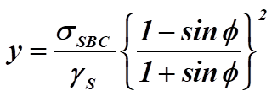
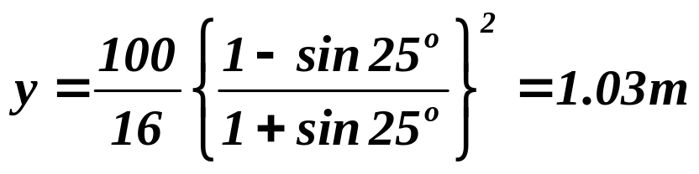
Solution
Depth of Foundation
Using Rankine’s Formular above
Hence, provided Depth of Foundation
D = 1.1 m

Slide 40
Width of Foundation
Loads/m run
Weight of wall = 0.25 × 2.5 × 1 × 18.85 = 11.78 kN/m
Weight of foundation = 0.15 × 11.78 = 1.77 kN
(Assuming 15% of superimposed load)
Total gravity load = 13.55 kN
Total wind load on wall/m run = 0.3 × 2.5 × 1 = 0.75 kN/m acting at 2.5/2 + 1.1 = 2.35 m form the base
∴ Moment about base = 0.75 × (1.25 + 1.1) = 1.763 kNm
Maximum pressure is equated with allowable bearing capacity and the value of bearing capacity is increased by 25% for wind load

Slide 41
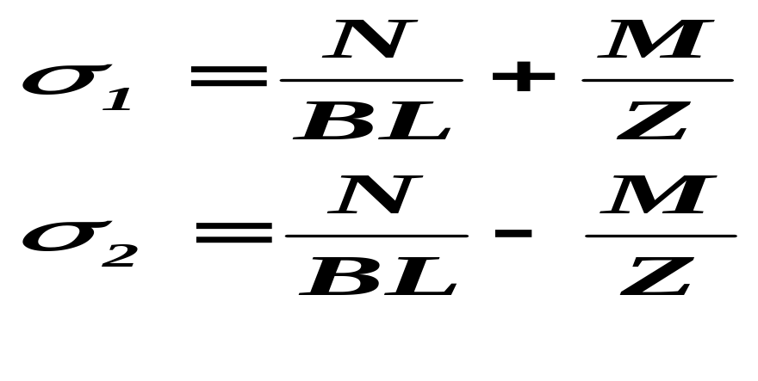
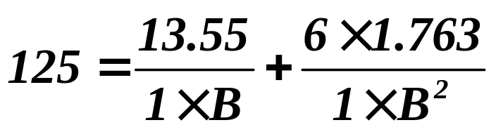
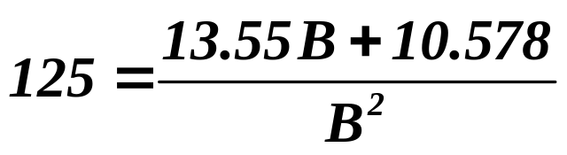
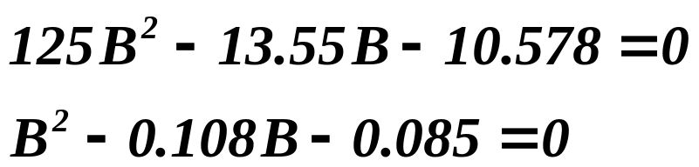
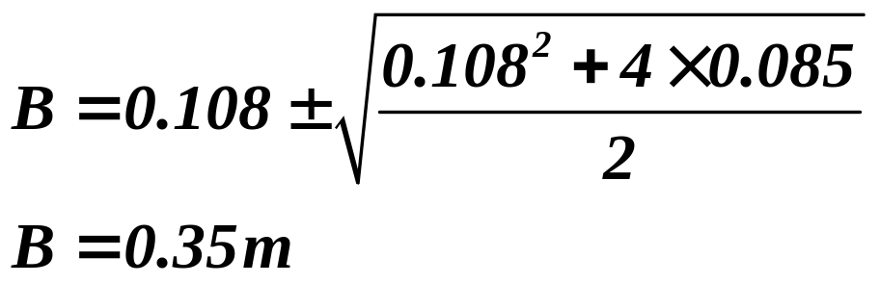
or,

Slide 42
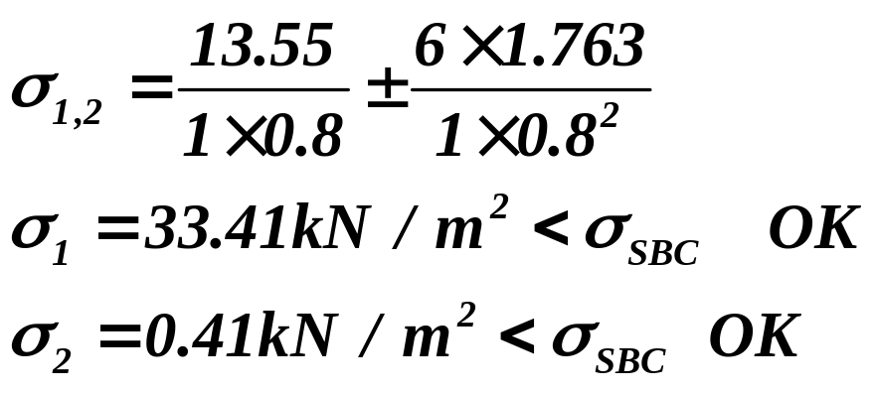
Bmin = (W + 30) cm = (25 + 30) = 55 cm
Bmin = 0.55 > 0.35 m
Again to have compressive pressure on the whole area of footing, eccentricity e ≤ B/6
Here, e = M/P = 1.763/15.55 = 0.13 m < 0.55/6 = 0.092m
Since actual e > B/6, increase the width of footing to 80 cm
Therefore, B/6 = 0.8/6=0.133 > 0.13 OK
Check for Pressure

